Slide 1



Your Eco Church 2023
Climate Justice

Slide 2
Outline of session
Eco Church – Community and Global Engagement
Why Climate Justice
What Christian Aid does and one Church’s story
Practical Ideas for Christian Aid Week
Campaigning and lobbying for Climate Justice – St Peter’s Maney
Additional questions and discussion session

Slide 3
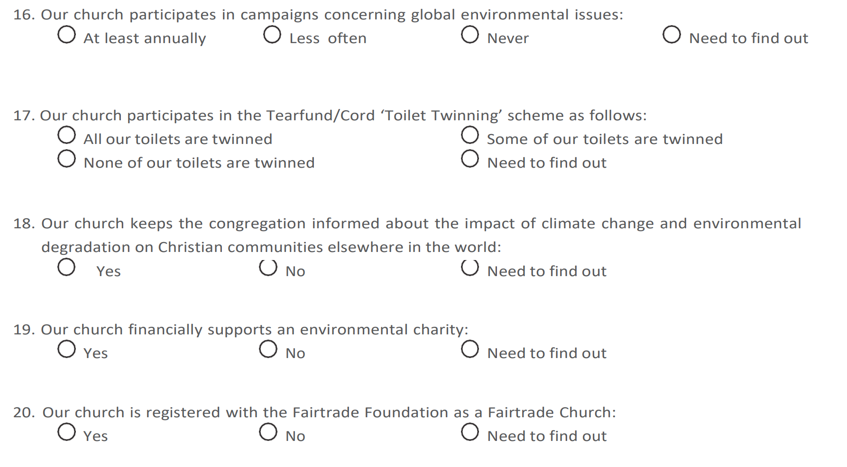
Eco Church Framework
Worship & Teaching
Buildings
Land
Community &
Global Engagement
5. Lifestyle

Slide 4

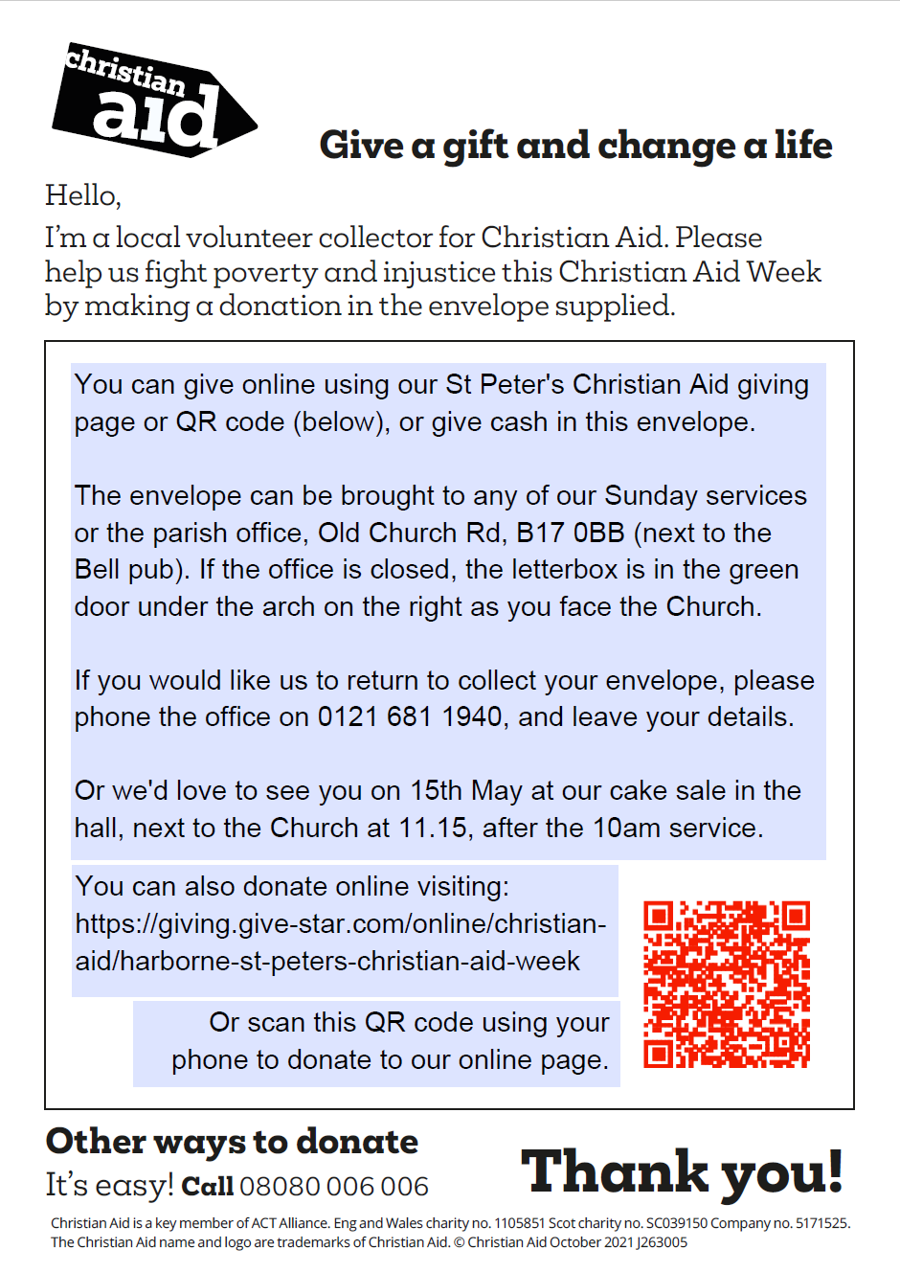
St Peter’s - Delivery Only House-to-House

Slide 5
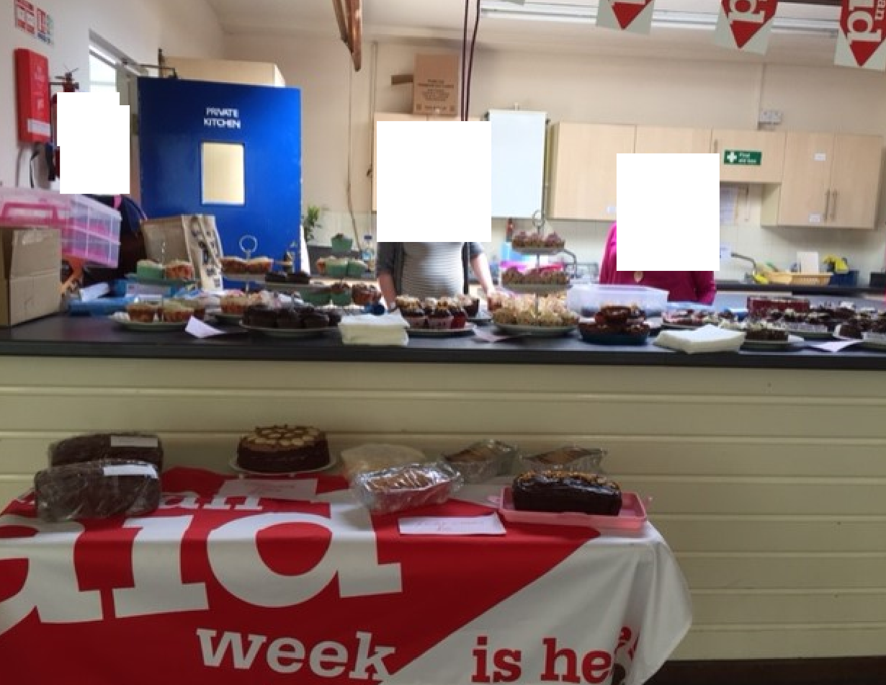
St Peter’s Harborne and Christian Aid Week
In addition to delivering envelopes,
we’ve tried:
Cashless Giving - Online giving & QR codes
Mention in prayers and preaching
Junior Church activity
Collection during the Service
Cake Sales
Big Brekkie
Street Collection
Our junior school collection

Slide 6

Break Out Questions
From what you have heard and seen, are there things you feel your Church could do this Christian Aid Week?
What further support would help you?

Slide 7
Questions and Discussion
8.30 – 9.00 pm

