Slide 1


Warm Churches
Danger – Opportunity

Slide 2

Warm Churches : Danger- Opportunity
Support Network
Deanery Environmental Champions (DEC)
Parish Environmental Contacts (PEC)
Property Team
National Environmental Programme
Zoom- watch replays on You Tube channel ChurchCare @churchcare5432 - now72 videos covering every topic towards Net Zero- for a particular topics ask DEC or BACA member.
Notes:
2

Slide 3
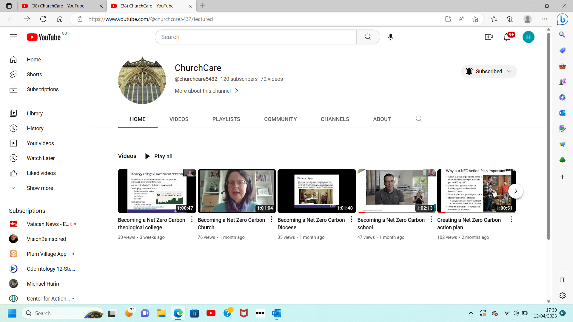
72 church care videos - press to view click control & left click together

Slide 4
Reduce Energy Use
Barnt Green & Cofton Hackett
Mike Powell PEC
How do we know if the actions we take to reduce energy use are effective?
Mike along with their church Green Group took regular monthly meter readings.
Kept records and so they could see usage trends.
They were keen to understand their current energy usage before making any changes.
Any changes they made they could see the impact of those changes.
They tracked energy usage including impact of their new boiler, new boiler controls, installation of LED lighting.
Analysis of monthly usage was vital to see that nothing was going wrong- heating inadvertently left on, heating control failures, hot taps leaking. Etc.

Slide 5
Shirley Parish Church hall retrofit/renovation
Funding Veolia (£25.4K) Lottery Community Fund (£10K) + donations totalling £5K
1. Old boiler replacement with ceiling hung electric infra red radiant heating panels
2. Programmable heating zones to minimise fuel use /cost.
3. Upgrade of circuitry- modern distribution board.
4. LED lighting, plus emergency lighting & timers for toilet lighting.
5. Insulation of loft & cold East Wall.
6. Making good & decoration.
For further information -kate_crocker@hotmail.com

Slide 6
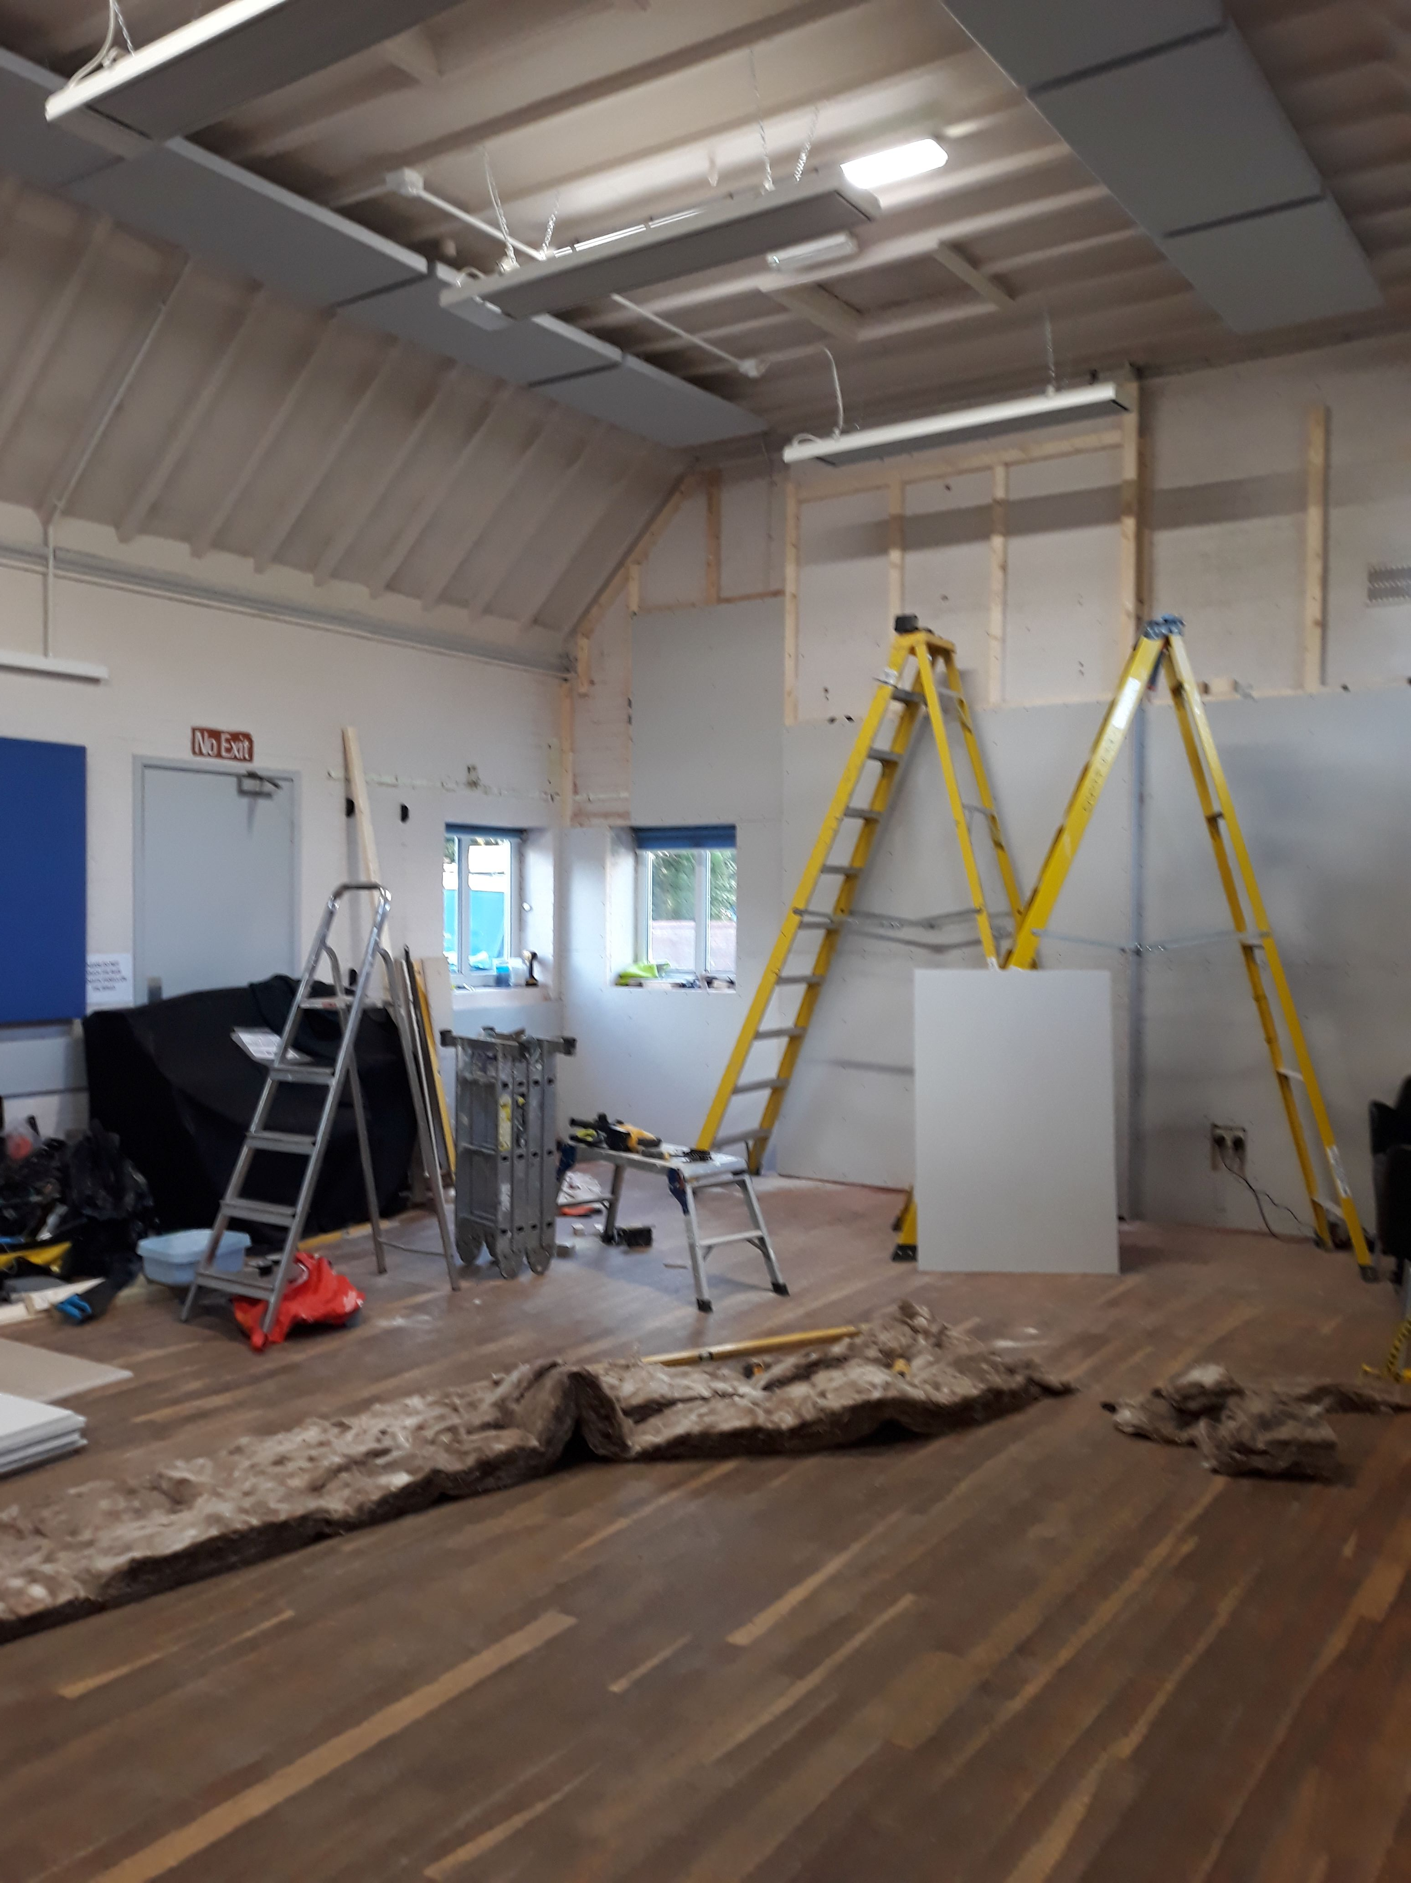
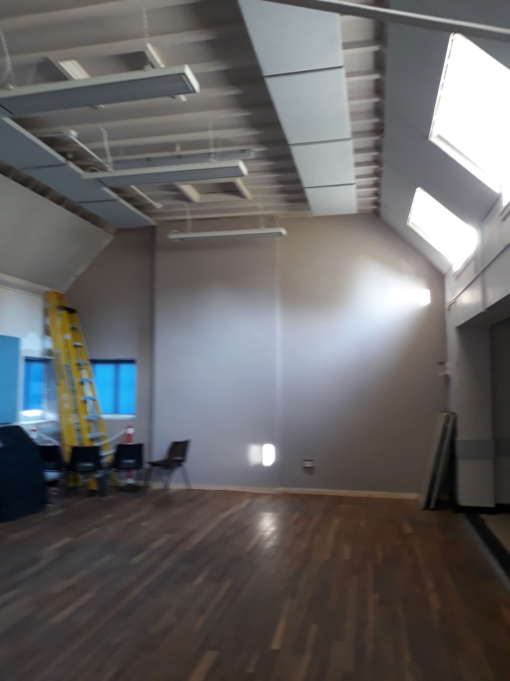
Shirley Church Hall
Before Insulation
After Insulation

Slide 7
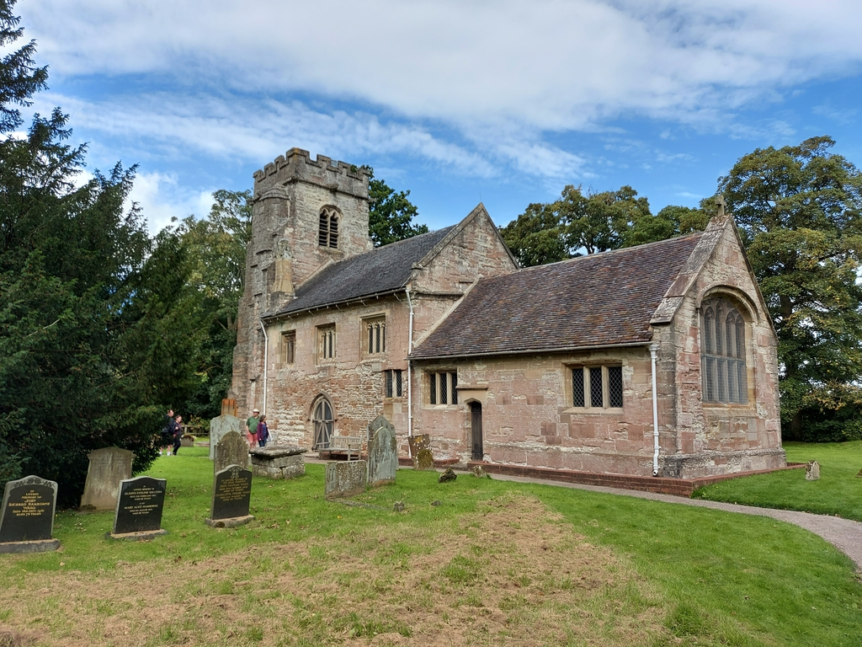
Net Zero
St Michael’s
Baddeley Clinton
Grade 2 listed building
Heating the People not the space
Electric Pew Heaters
LED lighting
Switching to a Green Electricity Provider

